Slide 1

Understanding political Polls
MCDA 5520 Case 3
Present by: Caner Irfanoglu
Diven Sambhwani
Madeleine Leong

Slide 2





Q1 & Q2
Q3 & Q4 & Q5
Q6 & Q7

Slide 3

1
Random Sample
What is Random Sample?
How to collect Random Sample?
The factors when designing a sample frame?
“38% will vote Liberal” Is this a fact or an estimate?

Slide 4
What is Random Sample?
Random sample is a sample from a given population where each individual/item has an equal chance of being selected
Random Sample
Minimize bias
Larger random sample size will lead an accurate estimation to the population.

Slide 5

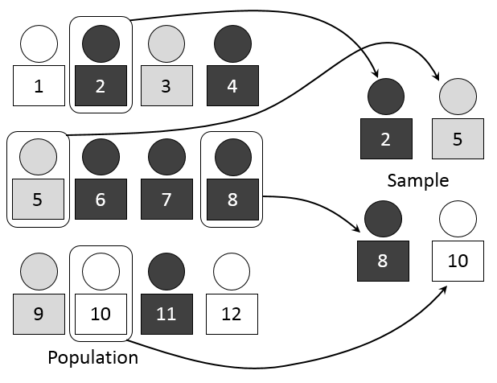
How would you go about collecting one?
The population frame (the list from which the sample is selected):
Registered voters
The method of sampling:
Simple random sampling
The operational procedures for collecting the data:
Registration-Based Sampling (RBS)
Without replacement

Slide 6



What factors must you consider when designing a sample frame?
Age
Location
Gender
Income
Education

Slide 7
The case says that 38% will vote Liberal. Is this a fact or an estimate?
Only an estimate
Sample size of 2638 people
Is this sample size perfectly representing the population?
Sample is unbiased, we will have an accurate prediction from sample, knowing the nature of sampling error (1.9% points)

Slide 8

2
Sample Size & Confidence Level
What “accurate within 1.9% points” mean?
The case says that the sample consisted of 2,638 people. Where did this number come from?
The case also says the results are accurate 19 times out of 20. What does this mean?

Slide 9

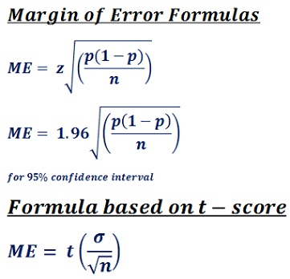
The case says that the survey is accurate within 1.9% points. What exactly does this mean?
1. 1.9% is the sampling error/margin of error
2. Occurs when the survey is only a sample, a subset of population
3. It can be minimized but cannot be avoided
4. Range of true value is below or above the sample statistic

Slide 10

The case says that the sample consisted of 2,638 people. Where did this number come from?
Formula :
$E=z∗\sqrt{\frac{\left(1−p\right)∗p }{n}}$
$\frac{z^{2}∗p∗(1−p)}{{(\frac{E}{100})}^{2}}=n$
Taking Margin Error as 1.908% the formula yields;
$\frac{1.96∗ 1.96∗0.5∗(1−0.5)}{{(\frac{1.908}{100})}^{2}} = 2638$

Slide 11
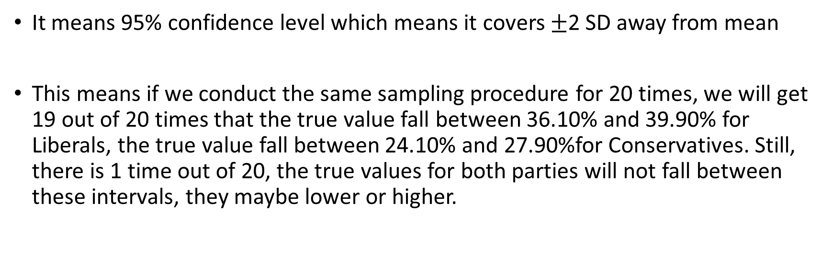
The case also says the results are accurate 19 times out of 20. What does this mean?
It means 95% confidence level which means it covers $±$2 SD away from mean
This means if we conduct the same sampling procedure for 20 times, we will get 19 out of 20 times that the true value fall between 36.10% and 39.90% for Liberals, the true value fall between 24.10% and 27.90%for Conservatives. Still, there is 1 time out of 20, the true values for both parties will not fall between these intervals, they maybe lower or higher.

Slide 12

3
Sample Size
The Ontario poll has 940 people whereas the nation poll had 2,638 people. Why this difference? How does the smaller sample size affect the results? How can they still be confident the poll is right 19 times out of 20?
The journalist said that support drops off dramatically after age 65. Do you agree with this statement? If not, why is he wrong?

Slide 13
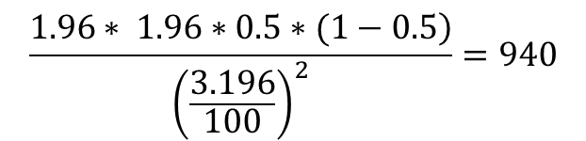

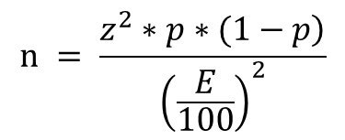
The Ontario poll has 940 people whereas the nation poll had 2,638 people. Why this difference?
$$͢$$
$$n = \frac{\left.z^{2}∗p∗(1−p\right)}{{\left(\frac{E}{100}\right)}^{2}}$$
$$\frac{\left.1.96∗ 1.96∗0.5∗(1−0.5\right)}{{\left(\frac{3.196}{100}\right)}^{2}}=940$$
How does smaller sample size affect the results?
Base | Sample | Large Population | Small Population
Population | Size | Margin of Error (%) | Margin of Error (%)
15,000,000 | 10,000 | 0.98 | 0.98
15,000,000 | 5,000 | 1.39 | 1.39
15,000,000 | 4,000 | 1.55 | 1.55
15,000,000 | 3,000 | 1.79 | 1.79
15,000,000 | 2,000 | 2.19 | 2.19
15,000,000 | 1,000 | 3.10 | 3.10
15,000,000 | 500 | 4.38 | 4.38
15,000,000 | 250 | 6.20 | 6.20
15,000,000 | 100 | 9.80 | 9.80
Table: Margin Error vs. Sample Size values
Figure: Margin Error vs. Sample Size line chart

Slide 14
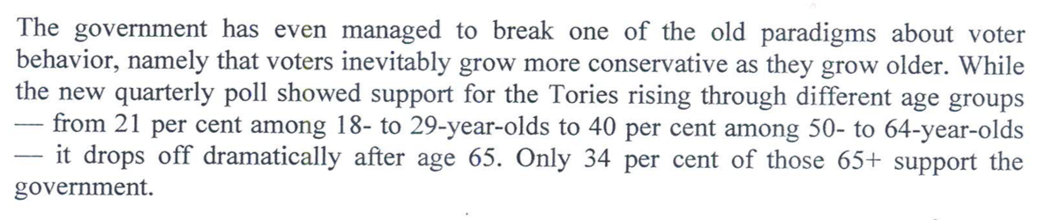
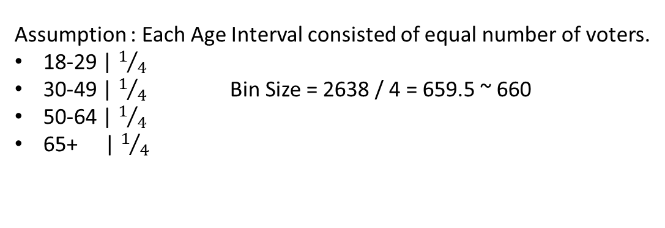
The journalist said that support drops off dramatically after age 65. Do you agree with this statement? If not, why is he wrong?
Assumption : Each Age Interval consisted of equal number of voters.
18-29 | $1/4$
30-49 | $1/4$ Bin Size = 2638 / 4 = 659.5 ~ 660
50-64 | $1/4$
65+ | $1/4$
E ≃ 4 %
Age | 18-29 | 50-64 | 65+
Sample Percentage | 21% | 40% | 34%
Population Interval | 17% - 25% | 36% - 44% | 30% - 38%
Table: Conservative vote % vs. Age

Slide 15


